Slide 1
HAPTIC COMMUNICATION SYSTEM FOR DEAFBLIND
Project Guide : Anoop S Pillai
DONE BY:
ABDUL SALAM C
AISWARYA LAKSHMI
ALNITTO P THOMAS
APOORVA ELIZA JOHN

Slide 2
Who are “Deaf Blind” ?
Deaf blindeness is a unique disability which combines varying degrees of both visual and hearing impairment.
All individuals who are deaf blind experience extreme challenges with communication and mobility.
In India, an estimated 5,00,000 people; both children and adult; are deaf blind.(survey conducted by sense international India)
There is little awareness about the deaf blind in india.

Slide 3
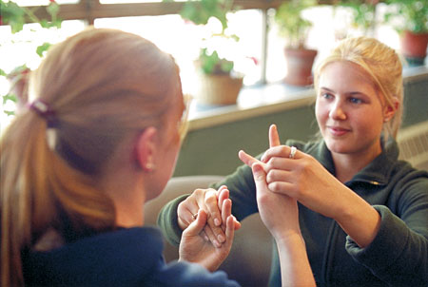
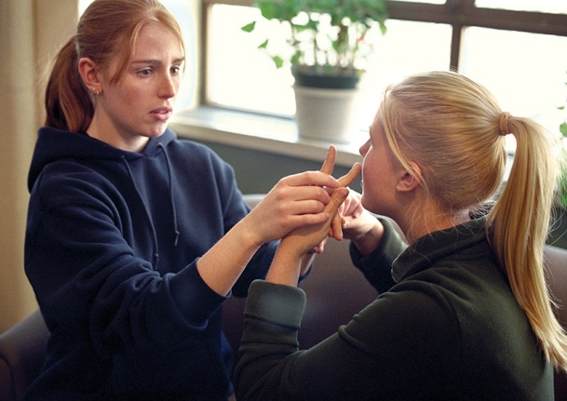
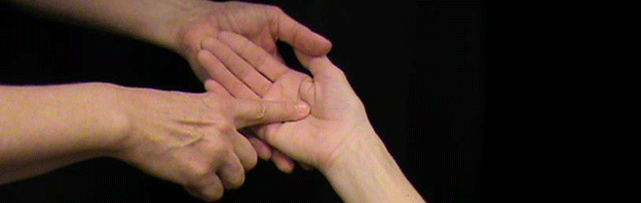
Communication between deaf blind
They use different methods of communication. The communication method vary with each person depending on the causes and degree of visual and hearing impairment.
The most common methods are:
* Tactile sign language
* Print on palm or tadoma
* Braille , fingerspelling etc

Slide 4
Limitations
Any of the methods used by the deafblind has big limitation : Proximity
The people involved in the conversation has to be very near to each other. Either form of communication requires a tactile input.
That is to say, deafblind people are limited in communicating with people who are at greater distance away from them.
They may send a message using text or keyboard specially designed for them, but there has not been much innovations on them receiving a message.

Slide 5
WHAT IS HAPTICS ?
Haptic communication refers to the ways in which people and animals communicate, and interact via the sense of touch.
The use of touch signals emerged over time out of a natural instinct to share information with individuals who are deaf-blind about their surroundings in a quick and unobtrusive manner.
Haptic or kinesthetic communication recreates the sense of touch by applying forces, vibrations, or motions to the user.

Slide 6
OUR AIM
Any of the methods used by the deafblind has big limitation that is proximity.
So we thought of a solution
To reduce the dependence on proximity
To enable people with any degree of visual or auditory ability to interact with each other.
To enable long distance communication for the deafblind.
To enable these people who have been long ignored by society and mistaken to be mentally retarded to become active members of society

Slide 7
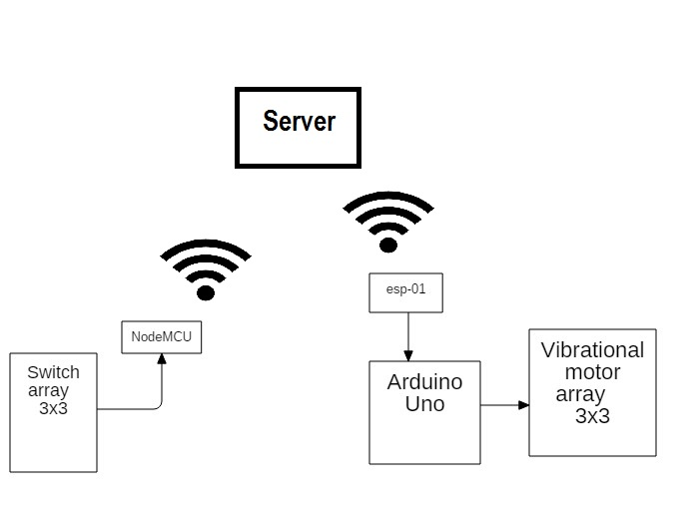
OUR PROJECT

Slide 8
COMPONENTS
Switch Array: A push-button (also spelled pushbutton) or simply button is a simple switch mechanism for controlling some aspect of a machine or a process.
An array of push button switches are used as input. The user can press the required pattern which will get transmitted.
NodeMCU module : Node MCU module has an in build ESP8266 based wifi transceiver, which is capable of creating a wifi hotspot region with WPA2PSK authentication.
It has 16 GPIO pins which can be configured both as input or output and an analog input pin for interacting with analog input signals.
Node MCU is capable of establishing IP based connectivity in one network.

Slide 9
ESP-01
ESP-01 is an ESP8266 board with 8 pins that allows microcontrollers to access a WiFi network and make simple TCP/IP connections using Hayes-style commands.
The ESP8266 is capable of either hosting an application or offloading all Wi-Fi networking functions from another application processor.
The ESP-01 has a dedicated UART interface with pinslabeled TX and RX. The TX pin is the ESP8266 transmission (outbound fromESP-01) and the RX pin is used to receive data (inbound into the ESP-01).

Slide 10
VIBRATION MOTOR : Vibration motor is a compact size coreless DC motor. Vibration motors are widely used in a variety of applications including cell phones, handsets, pagers, and so on.
The main features of vibration motor is the magnet coreless DC motor are permanent, which means it will always have its magnetic properties (unlike an electromagnet,which only behaves like a magnet when an electric current runs through it).
Another main feature is the size of the motor itself is small,and thus light weight.
Moreover, the noise and the power consumption that the motor produce while using are low
Here the vibration motor is used as a means to provide a feeling of touch on the receiver's hands.
The pattern transmitted by pushing the buttons from the input side is replicated by making the
corresponding motor vibrate thus creating the same pattern on the receiver's side.

Slide 11
WORKING
D:\finl pgm\VID_20170426_170418.mp4
..\Videos\Movavi Library\New Project.avi

Slide 12
FUTURE SCOPE
The input can be changed to a Touchpad. So that the pattern or symbol will have continuity and any kind of pattern can be drawn or recognized.
There is much research going on in the field of ultrasound haptics. In future, output can be changed to similar Haptic solution which can recreate the feeling of touch with pressure variations and also continuous patterns can be formed.
Connecting the server to the internet will provide global coverage for transmission.
An android and iOS app can be developed for normal phone users who can simply draw their messages on their phones and these can be transmitted via the server.

Slide 13
THANKYOU

